Slide 1

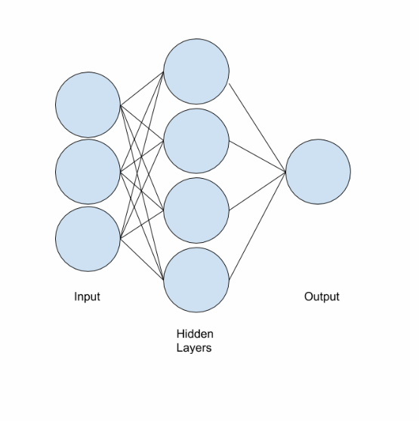
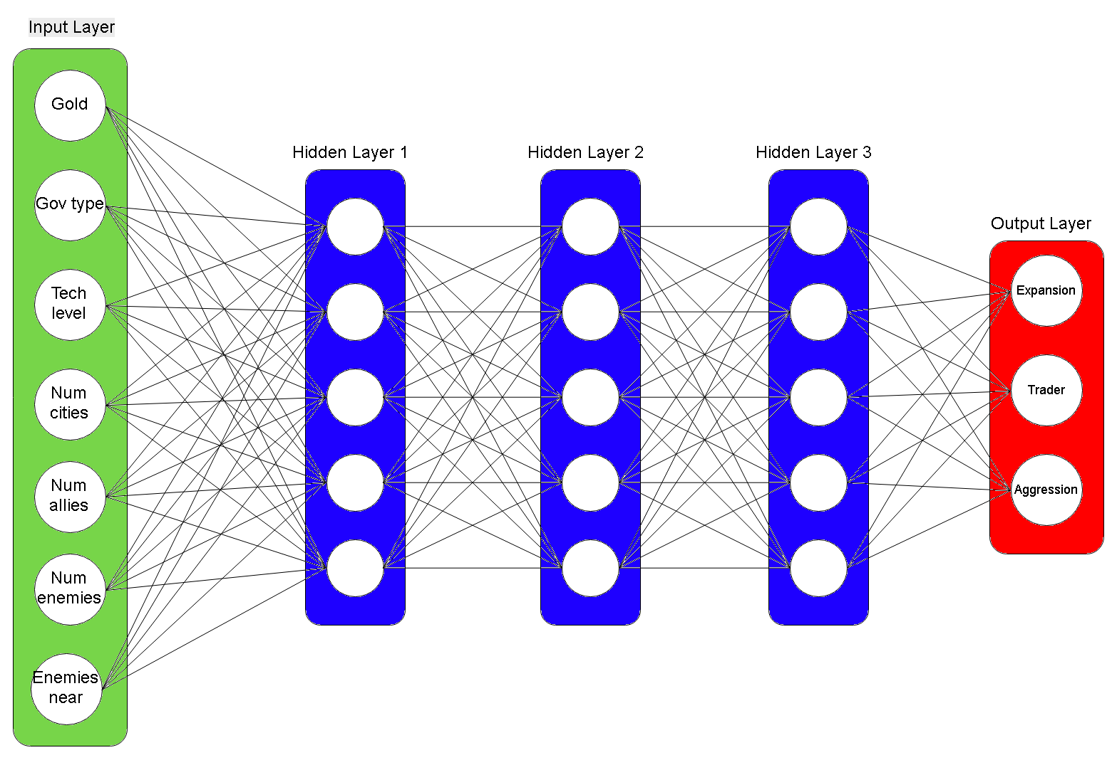
Artificial Civ: Deep Learning Strategies for Multiplayer Turn-Based Video Games Cohl Dorsey, Jackson Nelson, Bjorn Melin Dr. Erik Steinmetz
Introduction
Goals
Future Work
This project analyzes the performance of an artificial intelligence (AI) in a non-perfect information, stochastic video game: one where players do not know all available information, and has variables with elements of randomness. Whereas other projects of this nature have focused simply on the reaction of the AI to the pixels shown on the computer screen, we attempt to utilize methods of machine learning to teach the AI successful strategies in the video game Freeciv using game-state information. Our method of teaching the AI involves the use of a neural network and reinforced learning such that the AI player learns successful strategy. Our intended goal is to modify the AI such that it would use predictive behavior rather than reactive behavior when it takes an action.
Create a feed-forward deep neural network
Use TensorFlow
Create an unsupervised learning algorithm
Use reinforcement learning
Pending tasks for this project include developing a functional neural network, utilizing real data, or implementing any kind of training on the preexisting AI. We will continue working to develop our neural network and implement it with Freeciv over the coming months.
First, we will continue working to retrieve the necessary game-state information from Freeciv and write it to a separate file or pull it directly into the neural network.
Once this is accomplished, we will further improve the functionality of the neural network; initially such that it is able to process data from individual turns, then expanding to a full game, and finally to processing multiple games. The performance of the AI will be observed during each of these situations and document its success or failure. Hopefully, during each of these situations we are able to observe progress in improving the policies that the AI is using.
We will test the performance of the AI using our neural network over many thousands, if not millions, of simulation games and record the results. Our ultimate measure of success will be when we are able to observe that the AI is not only learning throughout a single game, but when it is able to begin each round with previous experience in mind, and therefore not beginning tabula rasa each game.
Results
A set of representative test data for playing freeciv was generated and stored to a .txt file. This dataset was inputted into the neural network which processed the data and allowed for the AI to learn from from each iteration of gameplay.
By running test data
Thus far, the structure of both our neural network and hook have been established but they are not yet at the complexity we desire for the final product.
The neural network has proved functional when dealing with the set of representative data generated. This means that we now have functioning base code which we may modify to accomplish our final goals for this project.
Recently we have figured out how to retrieve game-state information from freeciv and write it to a file. Currently, we are working on integrating this data into our neural network.
Method
The in-game AI is governed by three essential numeric traits that dictate the player’s actions: Trader, Expansionist, and Aggression. These traits, varying on a scale of 1-100, each work in tandem to guide the actions of the AI.
Rather than developing our own AI to play Freeciv, we instead chose to modify the preexisting AI by constructing a neural network that would take game-state information as inputs and return the three trait values as outputs.
These modified trait values would then be fed back into the game, and the relative difference in score between turns would signify a successful or unsuccessful turn.
The neural network would then use this difference to develop a policy for which values of the traits led to a more successful outcome, and thereby learn effective strategy within the game.
References
Buchanan, Bruce. “A (Very) Brief History of Artificial Intelligence.” AI Magazine, 2005, pp. 53–60.
LeCun, Yann, et al. “Deep Learning.” Nature, 28 May 2015, pp. 436–444.
Acknowledgements
Erik Steinmetz for advising
Augsburg University Computer Science Department
Augsburg University URGO Office
Figure 1: Model of our Neural Network. The seven input values appear on the left, pass through three hidden layers, and output the three trait values.
Figure 2: A Simple Neural Network. Simplified feedforward neural network.

